Slide 1


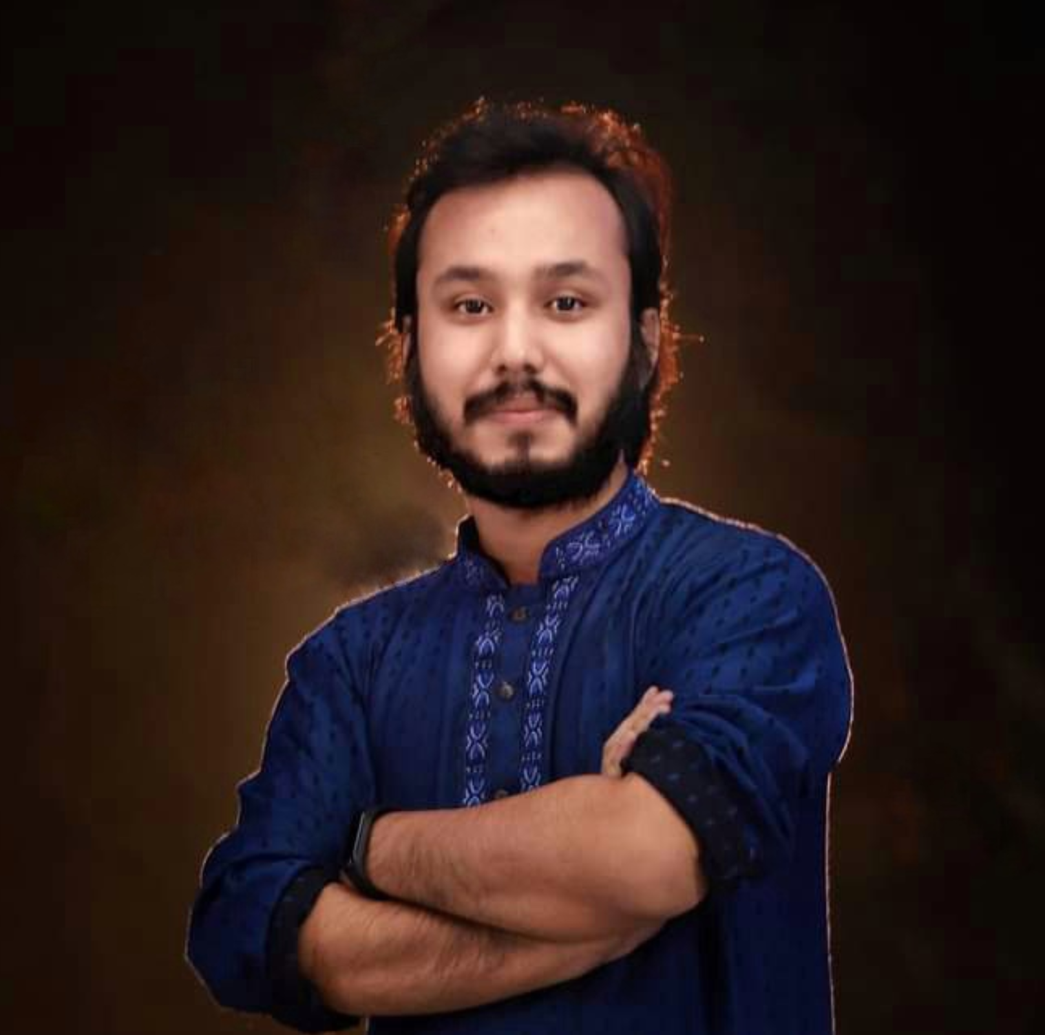
HSC’23 ICT free online class.
আই সি টি বইয়ের পূর্নাঙ্গ প্রিপারেশন
৬ টি অধ্যায়ের পড়া, MCQ, সৃজনশীল
কৌশিক রায়
Studying MSc in Computer Science (PMSCS)
Jahangirnagar University
#Dadar Class – দাদার ক্লাস

Slide 2
৩য় অধ্যায় (ক) ১ম অংশ
সংখ্যা পদ্ধতি
HSC ICT Full Book Preparation Online Class with Kowshique Roy

Slide 3

HSC ICT Full Book Preparation Online Class with Kowshique Roy

Slide 4

HSC ICT Full Book Preparation Online Class with Kowshique Roy

Slide 5

HSC ICT Full Book Preparation Online Class with Kowshique Roy

Slide 6

HSC ICT Full Book Preparation Online Class with Kowshique Roy

Slide 7

HSC ICT Full Book Preparation Online Class with Kowshique Roy

Slide 8

HSC ICT Full Book Preparation Online Class with Kowshique Roy

Slide 9

HSC ICT Full Book Preparation Online Class with Kowshique Roy

Slide 10
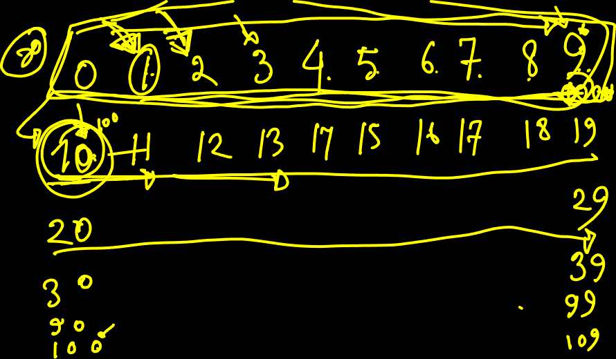
HSC ICT Full Book Preparation Online Class with Kowshique Roy

Slide 11

HSC ICT Full Book Preparation Online Class with Kowshique Roy

Slide 12
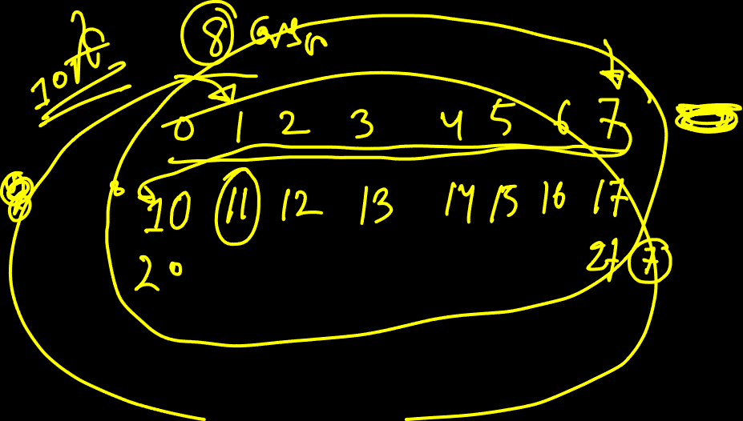
HSC ICT Full Book Preparation Online Class with Kowshique Roy

Slide 13

HSC ICT Full Book Preparation Online Class with Kowshique Roy

Slide 14

HSC ICT Full Book Preparation Online Class with Kowshique Roy

Slide 15

HSC ICT Full Book Preparation Online Class with Kowshique Roy

Slide 16

HSC ICT Full Book Preparation Online Class with Kowshique Roy

Slide 17

HSC ICT Full Book Preparation Online Class with Kowshique Roy

Slide 18

HSC ICT Full Book Preparation Online Class with Kowshique Roy

Slide 19

HSC ICT Full Book Preparation Online Class with Kowshique Roy

Slide 20

HSC ICT Full Book Preparation Online Class with Kowshique Roy

Slide 21

HSC ICT Full Book Preparation Online Class with Kowshique Roy

Slide 22

HSC ICT Full Book Preparation Online Class with Kowshique Roy

Slide 23

HSC ICT Full Book Preparation Online Class with Kowshique Roy

Slide 24
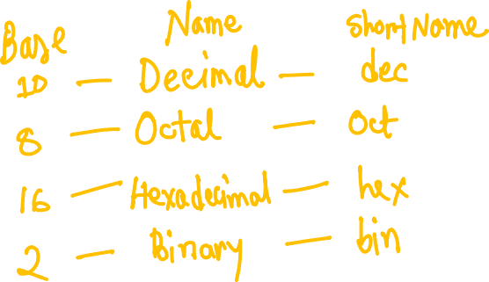
HSC ICT Full Book Preparation Online Class with Kowshique Roy

Slide 25

HSC ICT Full Book Preparation Online Class with Kowshique Roy

Slide 26

HSC ICT Full Book Preparation Online Class with Kowshique Roy

Slide 27

HSC ICT Full Book Preparation Online Class with Kowshique Roy

Slide 28

HSC ICT Full Book Preparation Online Class with Kowshique Roy

Slide 29

HSC ICT Full Book Preparation Online Class with Kowshique Roy

Slide 30

HSC ICT Full Book Preparation Online Class with Kowshique Roy

Slide 31

HSC ICT Full Book Preparation Online Class with Kowshique Roy

Slide 32

HSC ICT Full Book Preparation Online Class with Kowshique Roy

Slide 33

HSC ICT Full Book Preparation Online Class with Kowshique Roy

Slide 34

HSC ICT Full Book Preparation Online Class with Kowshique Roy

Slide 35

HSC ICT Full Book Preparation Online Class with Kowshique Roy

Slide 36

HSC ICT Full Book Preparation Online Class with Kowshique Roy

Slide 37

HSC ICT Full Book Preparation Online Class with Kowshique Roy

Slide 38

HSC ICT Full Book Preparation Online Class with Kowshique Roy

Slide 39

HSC ICT Full Book Preparation Online Class with Kowshique Roy

Slide 40

HSC ICT Full Book Preparation Online Class with Kowshique Roy

Slide 41

HSC ICT Full Book Preparation Online Class with Kowshique Roy

Slide 42
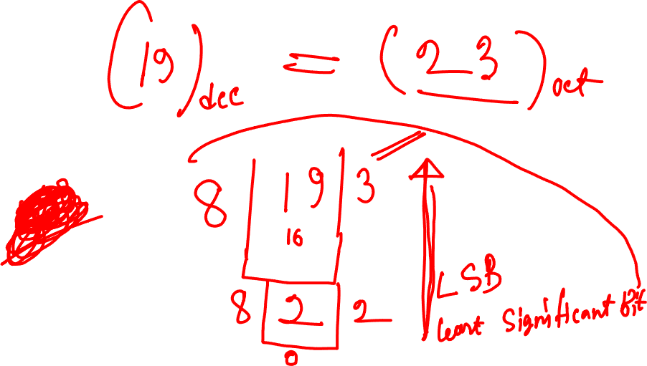
HSC ICT Full Book Preparation Online Class with Kowshique Roy

Slide 43
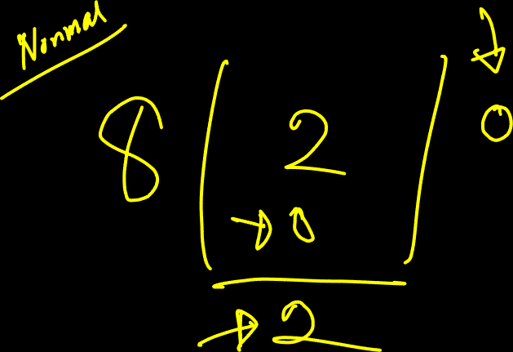
HSC ICT Full Book Preparation Online Class with Kowshique Roy

Slide 44
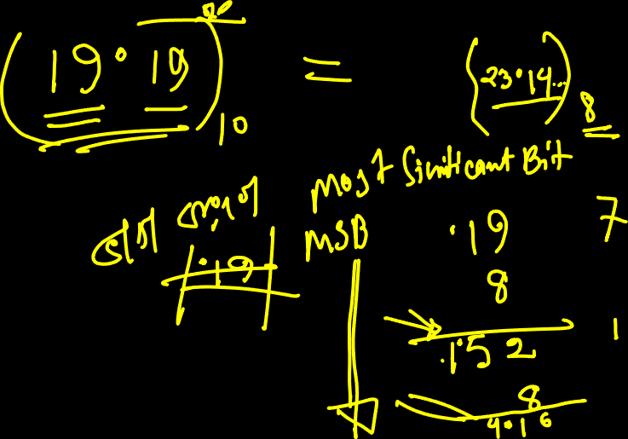
HSC ICT Full Book Preparation Online Class with Kowshique Roy

Slide 45
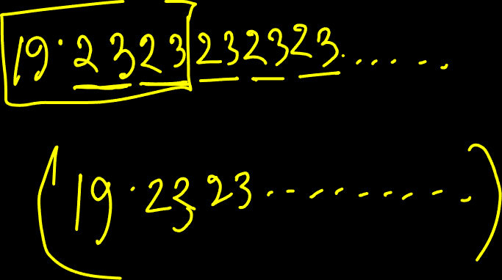
HSC ICT Full Book Preparation Online Class with Kowshique Roy

Slide 46
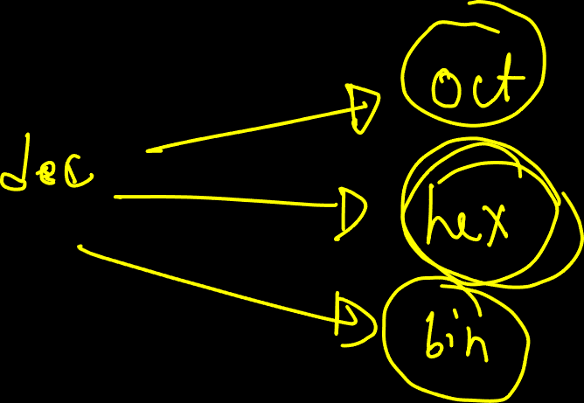
HSC ICT Full Book Preparation Online Class with Kowshique Roy

Slide 47
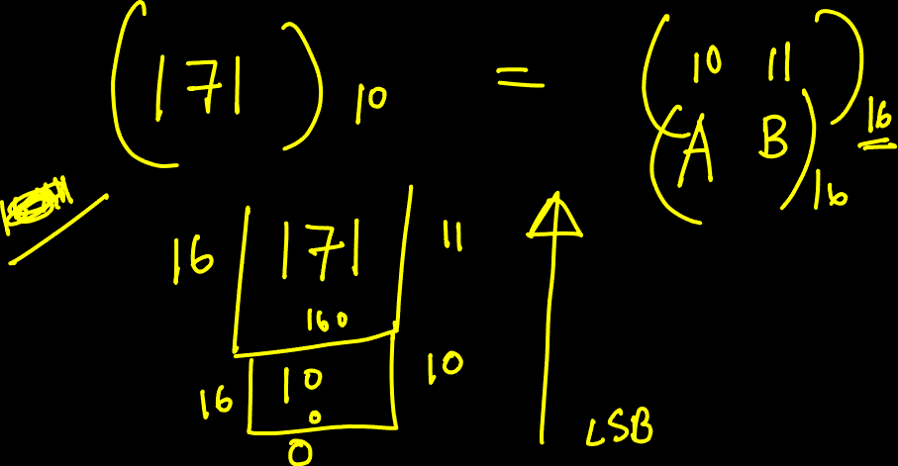
HSC ICT Full Book Preparation Online Class with Kowshique Roy

Slide 48
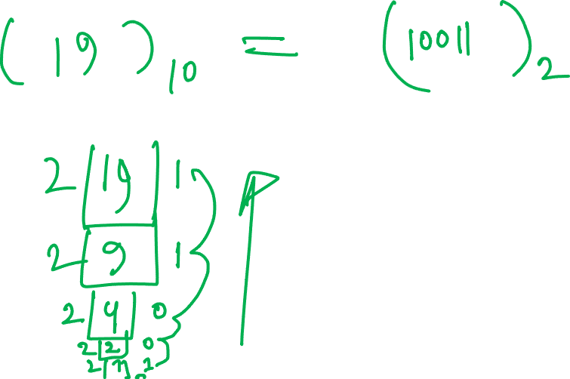
HSC ICT Full Book Preparation Online Class with Kowshique Roy

Slide 49
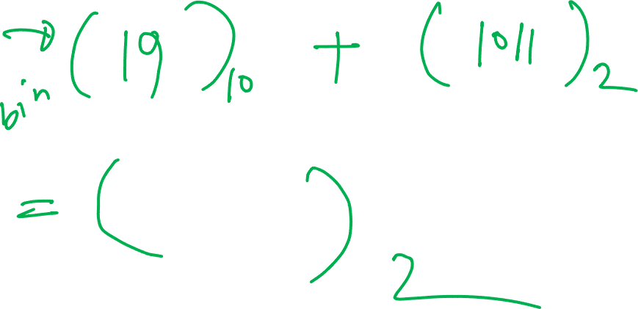
HSC ICT Full Book Preparation Online Class with Kowshique Roy

Slide 50
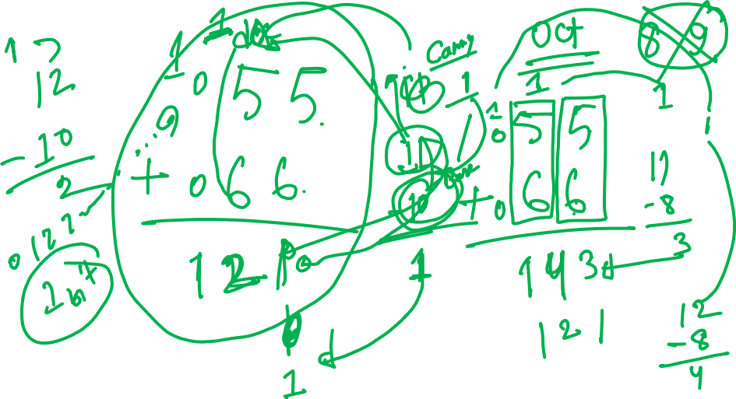
HSC ICT Full Book Preparation Online Class with Kowshique Roy

Slide 51
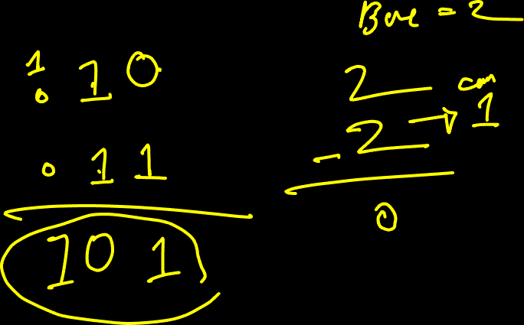
HSC ICT Full Book Preparation Online Class with Kowshique Roy

Slide 52
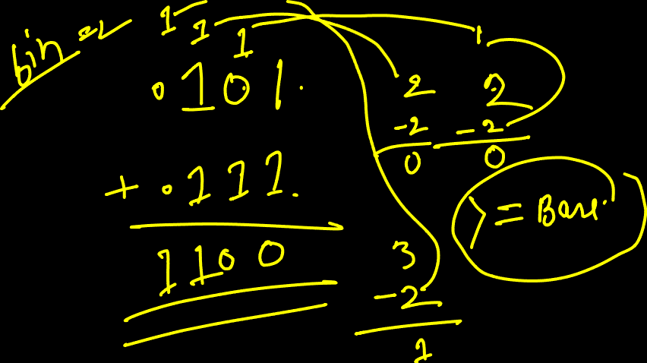
HSC ICT Full Book Preparation Online Class with Kowshique Roy

Slide 53
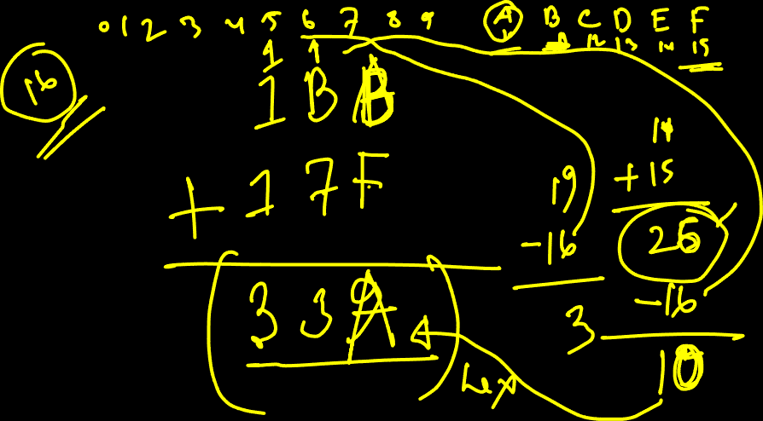
HSC ICT Full Book Preparation Online Class with Kowshique Roy

Slide 54
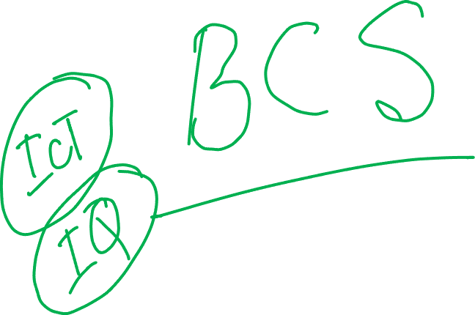
HSC ICT Full Book Preparation Online Class with Kowshique Roy

Slide 55
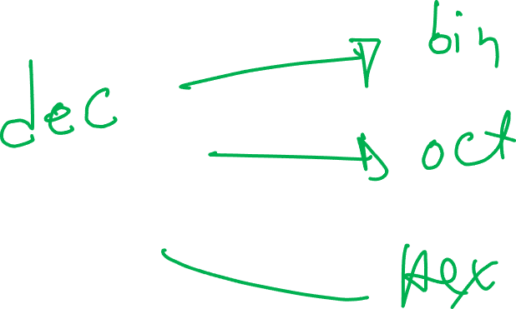
HSC ICT Full Book Preparation Online Class with Kowshique Roy

Slide 56

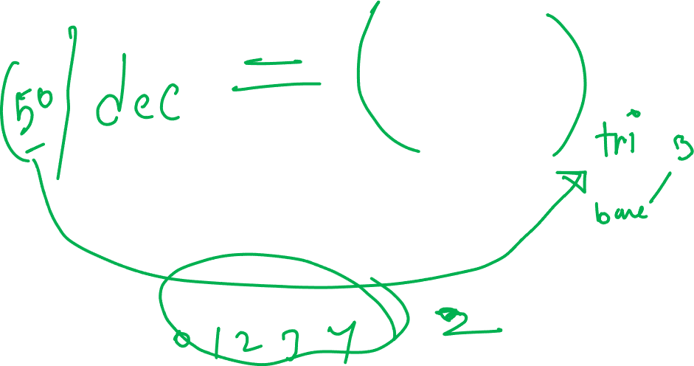
HSC ICT Full Book Preparation Online Class with Kowshique Roy

Slide 57

HSC ICT Full Book Preparation Online Class with Kowshique Roy

Slide 58

HSC ICT Full Book Preparation Online Class with Kowshique Roy

Slide 59
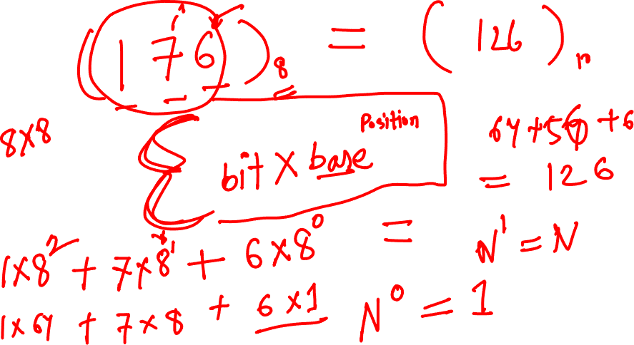
HSC ICT Full Book Preparation Online Class with Kowshique Roy

Slide 60

HSC ICT Full Book Preparation Online Class with Kowshique Roy

Slide 61
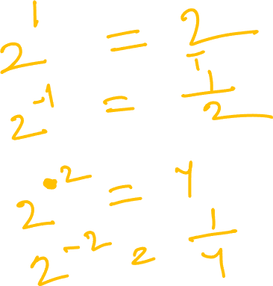
HSC ICT Full Book Preparation Online Class with Kowshique Roy

Slide 62
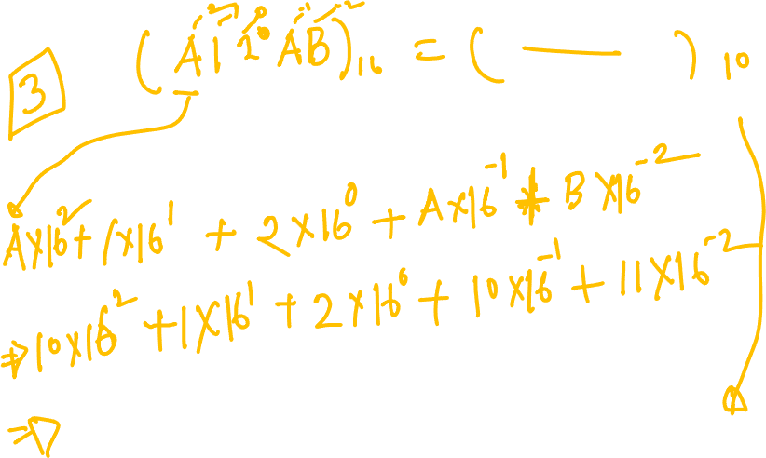
HSC ICT Full Book Preparation Online Class with Kowshique Roy

Slide 63

HSC ICT Full Book Preparation Online Class with Kowshique Roy

Slide 64

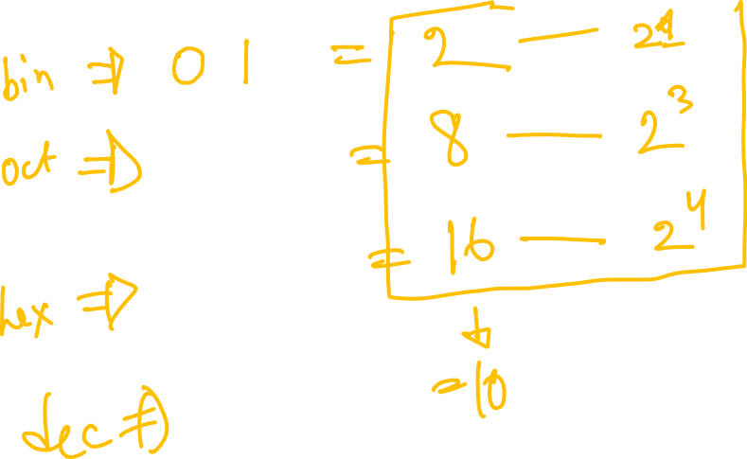
HSC ICT Full Book Preparation Online Class with Kowshique Roy

Slide 65
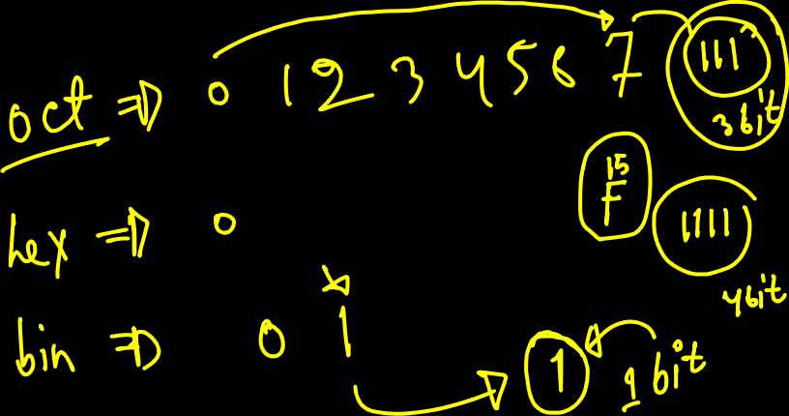
HSC ICT Full Book Preparation Online Class with Kowshique Roy

Slide 66

HSC ICT Full Book Preparation Online Class with Kowshique Roy

Slide 67
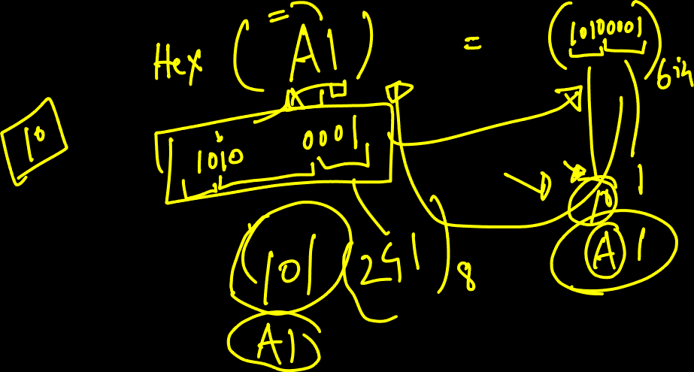
HSC ICT Full Book Preparation Online Class with Kowshique Roy

Slide 68
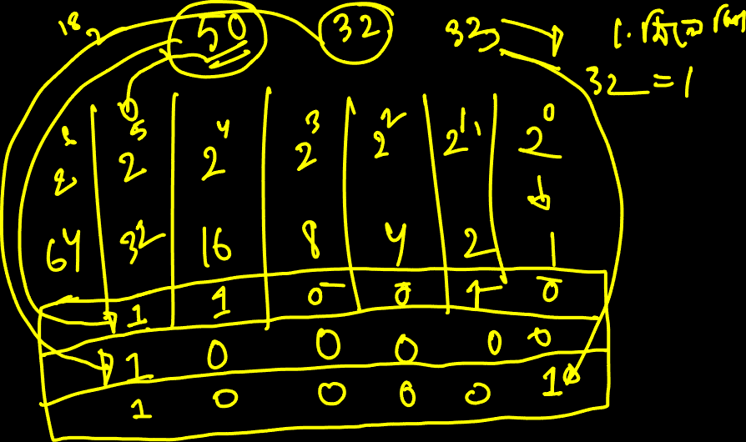
HSC ICT Full Book Preparation Online Class with Kowshique Roy

Slide 69
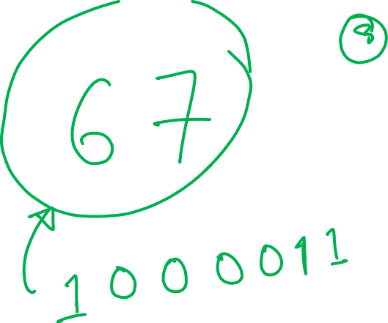
HSC ICT Full Book Preparation Online Class with Kowshique Roy

Slide 70
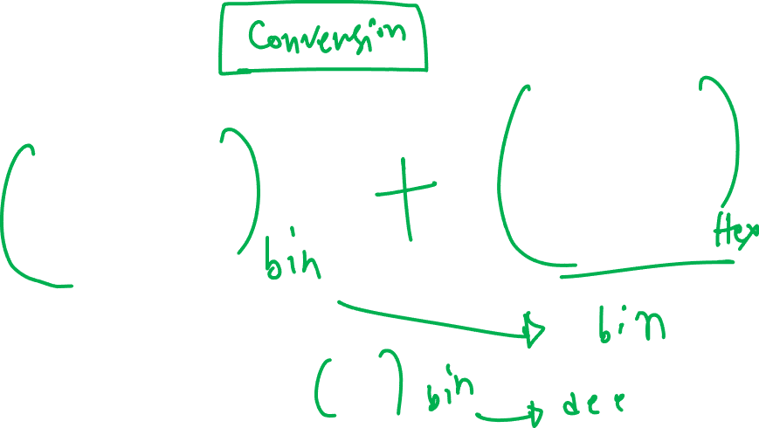
HSC ICT Full Book Preparation Online Class with Kowshique Roy

Slide 71
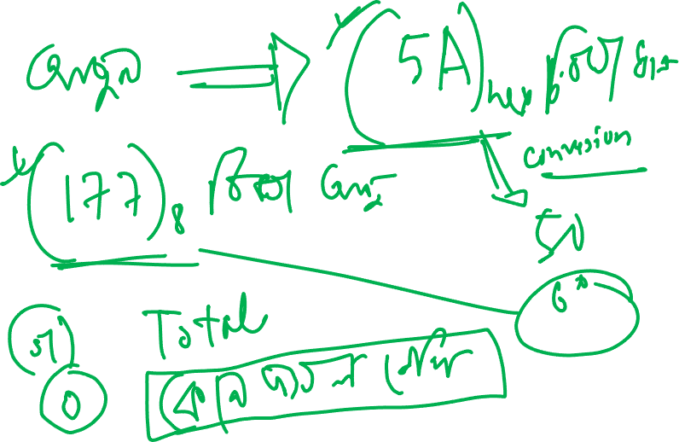
HSC ICT Full Book Preparation Online Class with Kowshique Roy

Slide 72

HSC ICT Full Book Preparation Online Class with Kowshique Roy

Slide 73
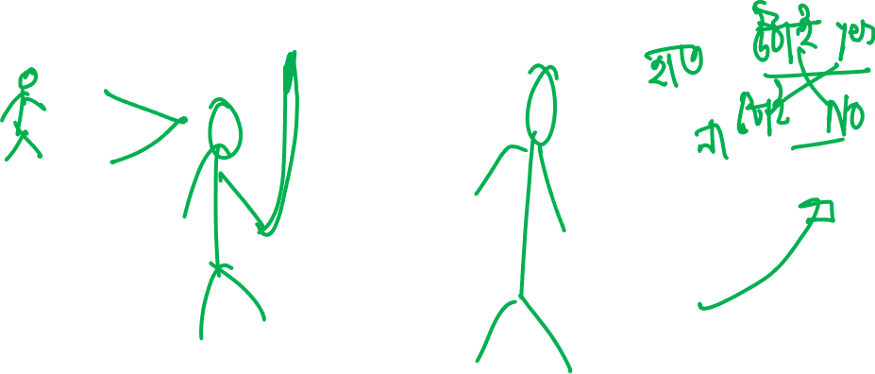
HSC ICT Full Book Preparation Online Class with Kowshique Roy

Slide 74
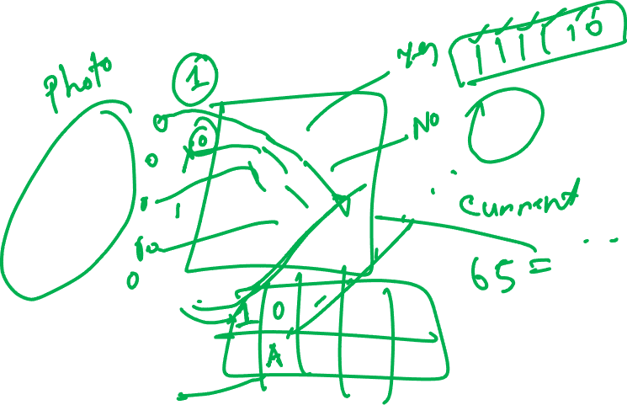
HSC ICT Full Book Preparation Online Class with Kowshique Roy

Slide 75
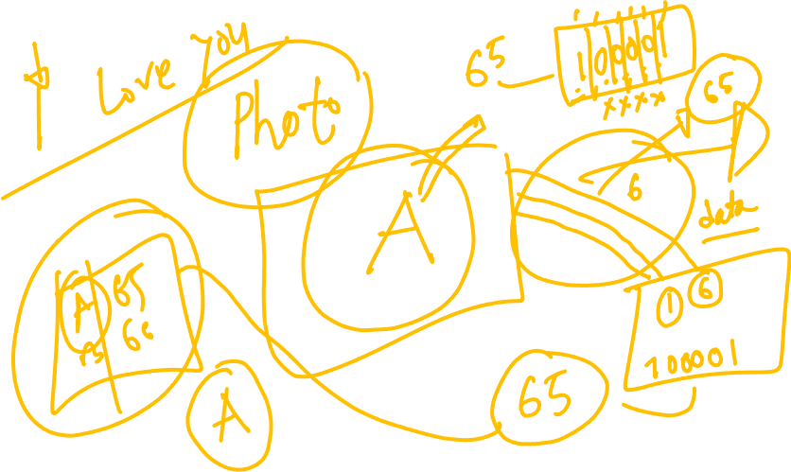
HSC ICT Full Book Preparation Online Class with Kowshique Roy

Slide 76
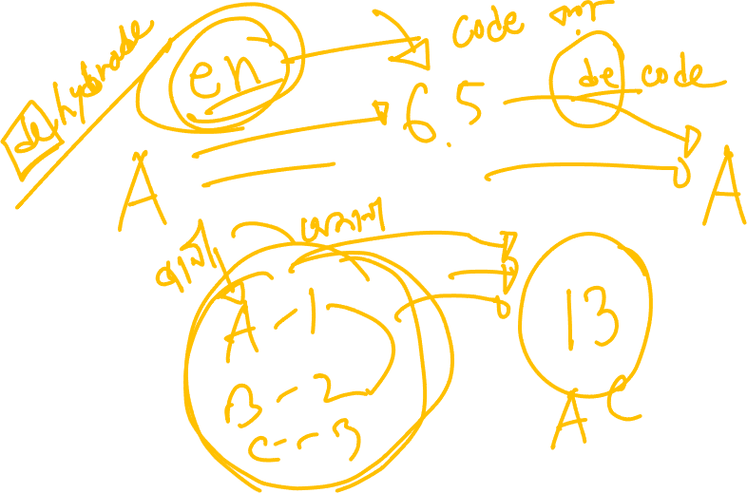
HSC ICT Full Book Preparation Online Class with Kowshique Roy

Slide 77
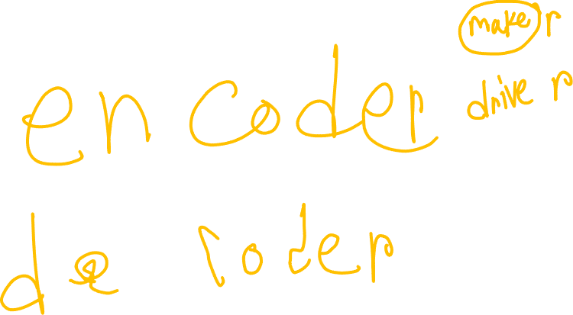
HSC ICT Full Book Preparation Online Class with Kowshique Roy

Slide 78

HSC ICT Full Book Preparation Online Class with Kowshique Roy

Slide 79

HSC ICT Full Book Preparation Online Class with Kowshique Roy

Slide 80
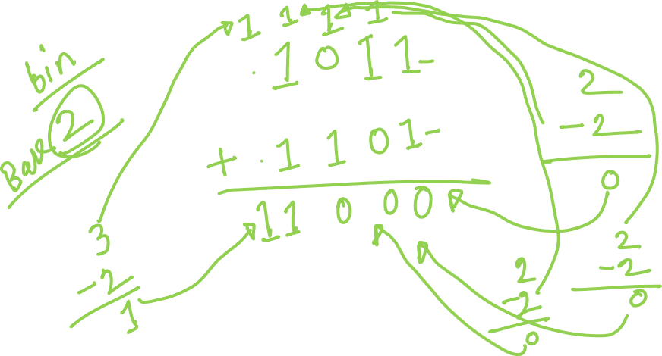
HSC ICT Full Book Preparation Online Class with Kowshique Roy

Slide 81
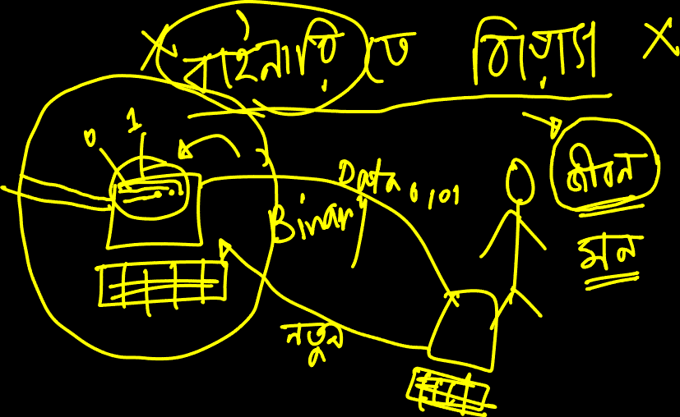
HSC ICT Full Book Preparation Online Class with Kowshique Roy

Slide 82
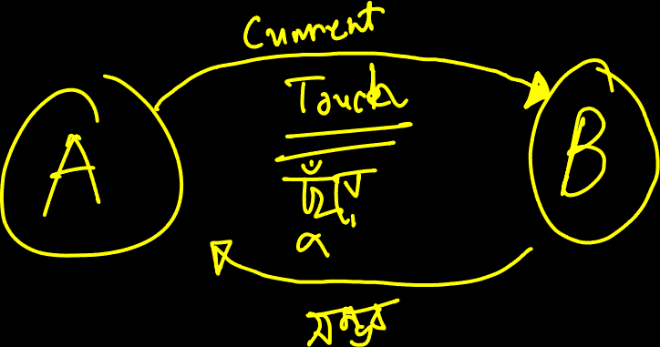
HSC ICT Full Book Preparation Online Class with Kowshique Roy

Slide 83
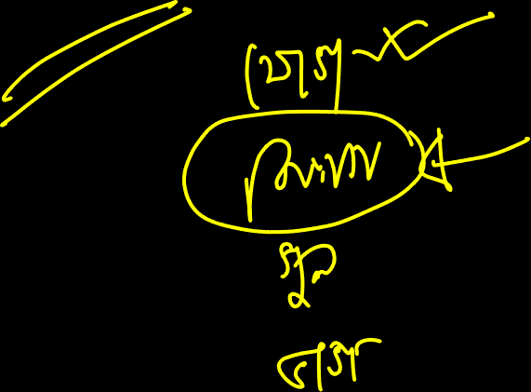
HSC ICT Full Book Preparation Online Class with Kowshique Roy

Slide 84
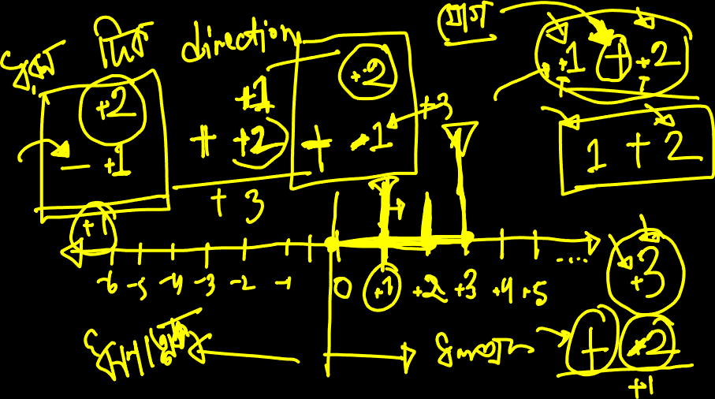
HSC ICT Full Book Preparation Online Class with Kowshique Roy

Slide 85
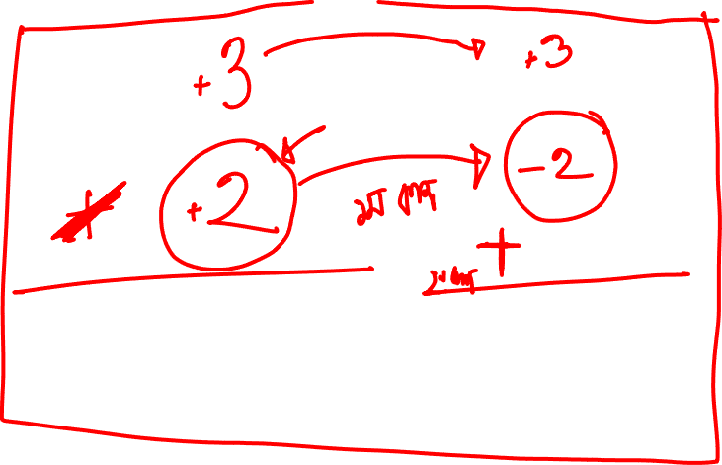
HSC ICT Full Book Preparation Online Class with Kowshique Roy

Slide 86
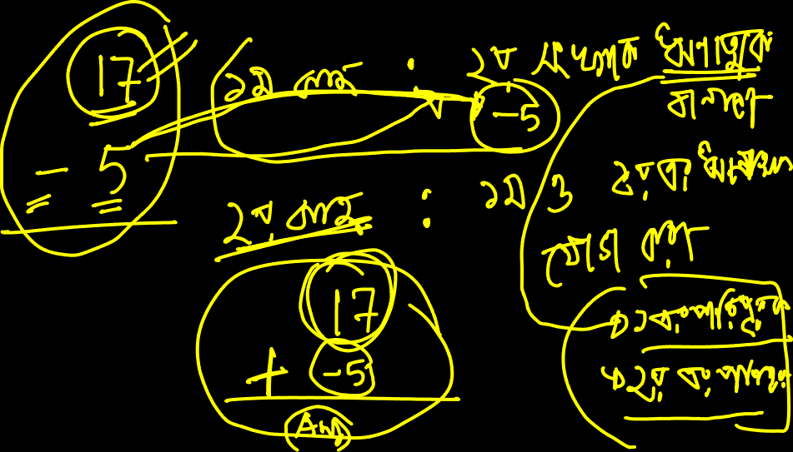
HSC ICT Full Book Preparation Online Class with Kowshique Roy

Slide 87
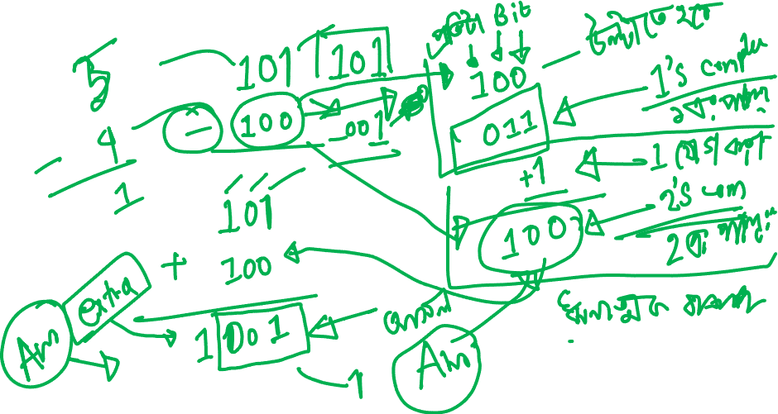
HSC ICT Full Book Preparation Online Class with Kowshique Roy

Slide 88
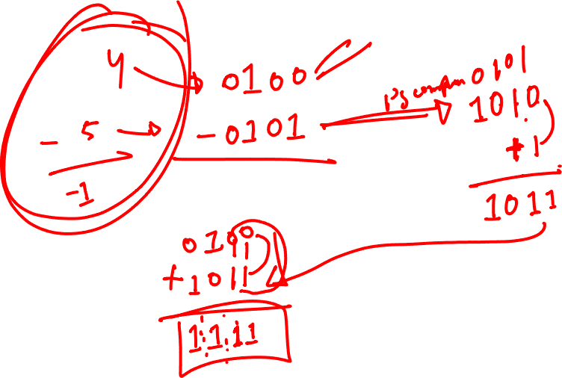
HSC ICT Full Book Preparation Online Class with Kowshique Roy

Slide 89

HSC ICT Full Book Preparation Online Class with Kowshique Roy

Slide 90
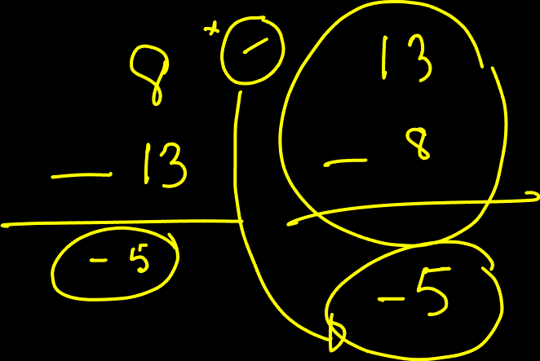
HSC ICT Full Book Preparation Online Class with Kowshique Roy

Slide 91
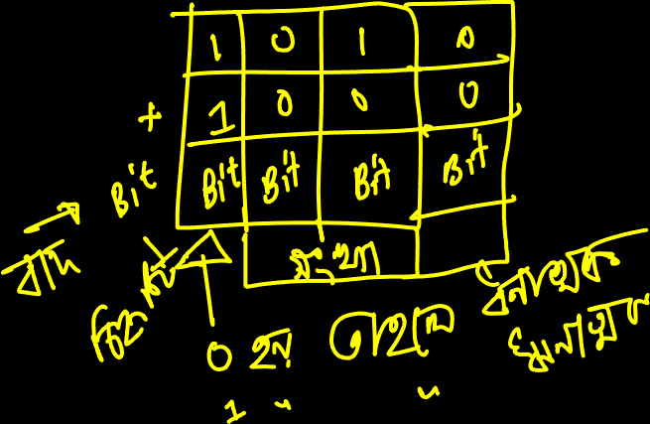
HSC ICT Full Book Preparation Online Class with Kowshique Roy

Slide 92
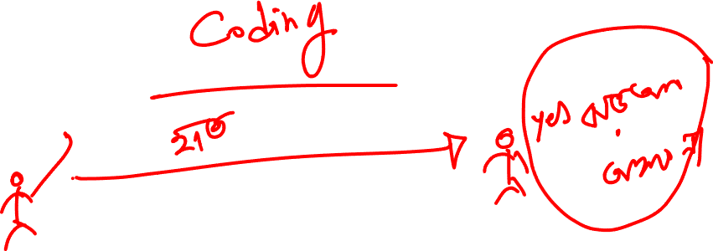
HSC ICT Full Book Preparation Online Class with Kowshique Roy

Slide 93

HSC ICT Full Book Preparation Online Class with Kowshique Roy

Slide 94
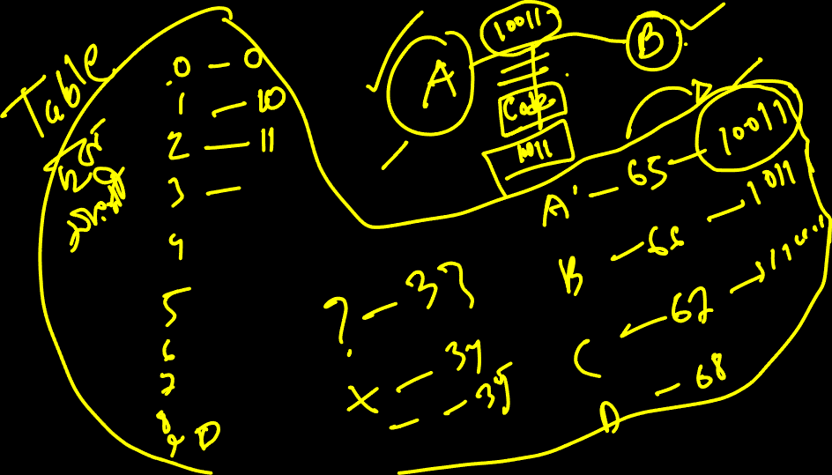
HSC ICT Full Book Preparation Online Class with Kowshique Roy

Slide 95
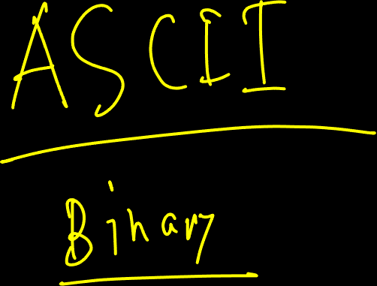
HSC ICT Full Book Preparation Online Class with Kowshique Roy

Slide 96
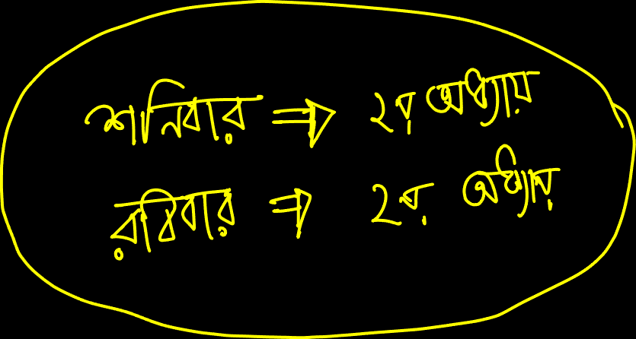
HSC ICT Full Book Preparation Online Class with Kowshique Roy

Slide 97
HSC ICT Full Book Preparation Online Class with Kowshique Roy

Slide 98
HSC ICT Full Book Preparation Online Class with Kowshique Roy

Slide 99
HSC ICT Full Book Preparation Online Class with Kowshique Roy

Slide 100
HSC ICT Full Book Preparation Online Class with Kowshique Roy

Slide 101
HSC ICT Full Book Preparation Online Class with Kowshique Roy

Slide 102
HSC ICT Full Book Preparation Online Class with Kowshique Roy

Slide 103
HSC ICT Full Book Preparation Online Class with Kowshique Roy

Slide 104
HSC ICT Full Book Preparation Online Class with Kowshique Roy

Slide 105
HSC ICT Full Book Preparation Online Class with Kowshique Roy

Slide 106
HSC ICT Full Book Preparation Online Class with Kowshique Roy

Slide 107
HSC ICT Full Book Preparation Online Class with Kowshique Roy

Slide 108
HSC ICT Full Book Preparation Online Class with Kowshique Roy

Slide 109
HSC ICT Full Book Preparation Online Class with Kowshique Roy

Slide 110
HSC ICT Full Book Preparation Online Class with Kowshique Roy

Slide 111
HSC ICT Full Book Preparation Online Class with Kowshique Roy

Slide 112
HSC ICT Full Book Preparation Online Class with Kowshique Roy

Slide 113
HSC ICT Full Book Preparation Online Class with Kowshique Roy

Slide 114
HSC ICT Full Book Preparation Online Class with Kowshique Roy

Slide 115
HSC ICT Full Book Preparation Online Class with Kowshique Roy

Slide 116
HSC ICT Full Book Preparation Online Class with Kowshique Roy

Slide 117
HSC ICT Full Book Preparation Online Class with Kowshique Roy

Slide 118
HSC ICT Full Book Preparation Online Class with Kowshique Roy

Slide 119
HSC ICT Full Book Preparation Online Class with Kowshique Roy

Slide 120
HSC ICT Full Book Preparation Online Class with Kowshique Roy

Slide 121
HSC ICT Full Book Preparation Online Class with Kowshique Roy

Slide 122
HSC ICT Full Book Preparation Online Class with Kowshique Roy

Slide 123
HSC ICT Full Book Preparation Online Class with Kowshique Roy

Slide 124
প্রশ্ন?
HSC ICT Full Book Preparation Online Class with Kowshique Roy

